Slide 1

3in1 Popular Food Indo China American
https://3in1popularfood.wordpress.com/
University of Memphis
MIS-7710
Professor: Scott W Vann
GROUP 2 MEMBERS
Sushmitha Thogaranahally Nagaraju
Hong Shi
Juliet A Onyando

Slide 2
The goal of the Project
Providing more quality content on websites.
Regularly adding new information, establishing trust, and marketing your site on other websites and social media.
Providing good user experience and helping our website visitors access and navigate your website with ease.
Drive more traffic, engage prospects, generate leads, and re-engage existing customers.

Slide 3
About Our Website
The website URL is https://3in1popularfood.wordpress.com/
We provide Indian, Chinese, and American popular cuisine in one place.
Customers can order a variety of food on our website.
Reserve a table and pre-order for dine-in, Online Order for delivery, or to-go.
Allow customers to modify the existing order or choose delivery for up to the next day.
Provide ingredients for each item on the menu.
Customer can track their order or pre-book their order to save wait time.
Customer service works 24/7.

Slide 4

Logo design
Used FreeLogoDesign.org to create our logo.
business name – 3IN1 Popular Food
the tagline “Taste your choice”,
A colorful circle with drawings of kitchen knives is our indication
the theme font we have used is Calibri with size 11.
The meaning behind the tagline is that whatever the choice made by the customer, they can taste it as they expected in our restaurant.
It is our first franchise in Memphis that started in the year 2022.
The mixed color is the indication of refreshment, growth, health, and teamwork of our restaurant employees.

Slide 5
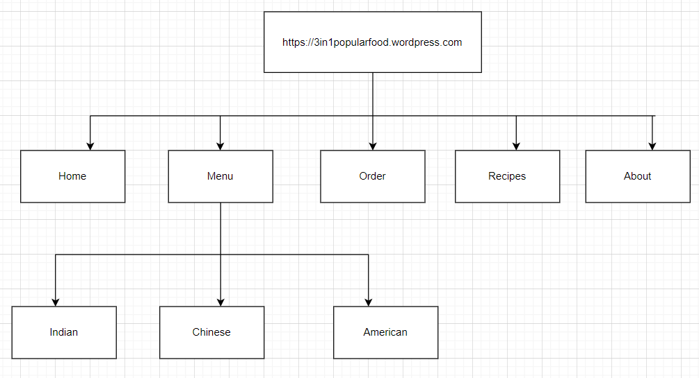
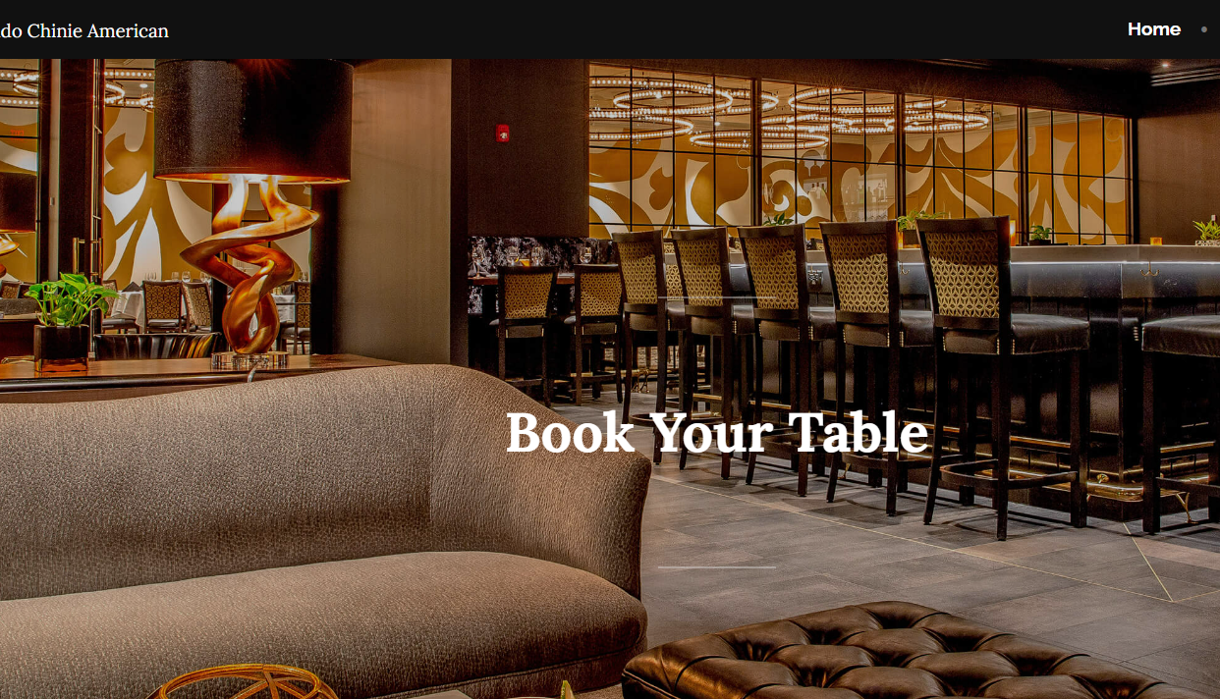
Web design
website address https://3in1popularfood.wordpress.com
Build by WordPress
Domain name matches the business idea
Security website(HTTPS:)
Parent-Child pages
Permalinks
pages
Blog
post

Slide 6

Marketing Strategies
Social media
Facebook
Instagram
Paid web ads
Cooking blogs
Email campaign
Newsletters
Sign up forms
Instagram https://www.instagram.com/3in1popularfood/?igshid=YmMyMTA2M2Y%3D​
Facebook https://www.facebook.com/people/3in1popularfood/100086522437073/​
Notes:
Based on the target customer, marking is designed around local influences on social media, paid web ads, and traditional marking. Local influencers who travel a lot will be invited to the restaurant to enjoy discounted food in exchange for a social media post. The target influencer will be someone who has an active following and regularly posts. The goal of the post is for the influencer to share how the food reminds them of an experience while traveling.
Based on the target customer, marking is designed around local influences on social media, paid web ads, and traditional marking. Local influencers who travel a lot will be invited to the restaurant to enjoy discounted food in exchange for a social media post. The target influencer will be someone who has an active following and regularly posts. The goal of the post is for the influencer to share how the food reminds them of an experience while traveling.
Based on the target customer, marking is designed around local influences on social media, paid web ads, and traditional marking. Local influencers who travel a lot will be invited to the restaurant to enjoy discounted food in exchange for a social media post. The target influencer will be someone who has an active following and regularly posts. The goal of the post is for the influencer to share how the food reminds them of an experience while traveling.

Slide 7
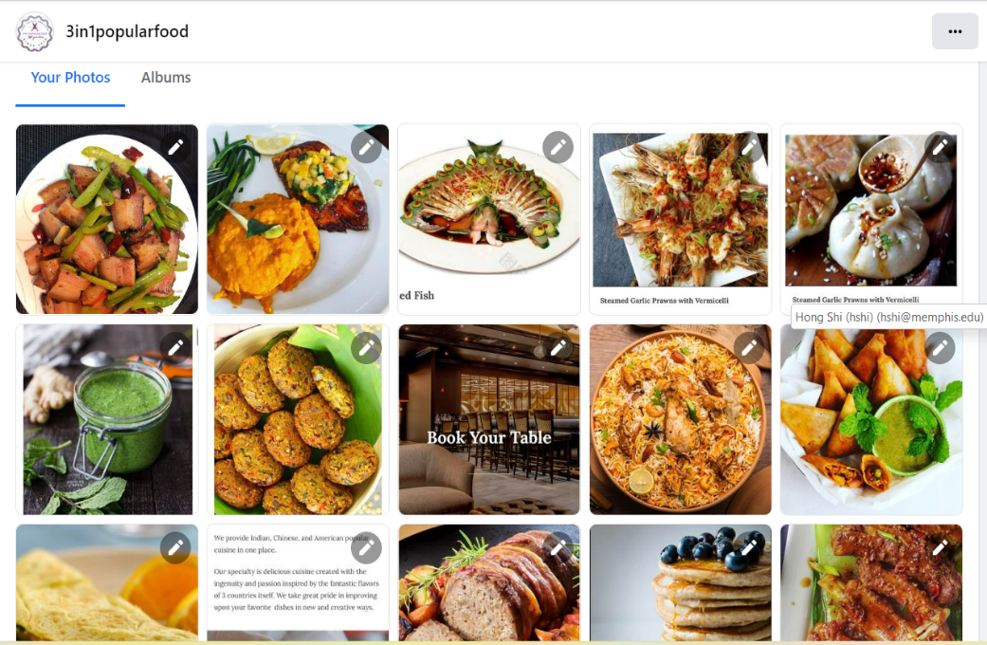
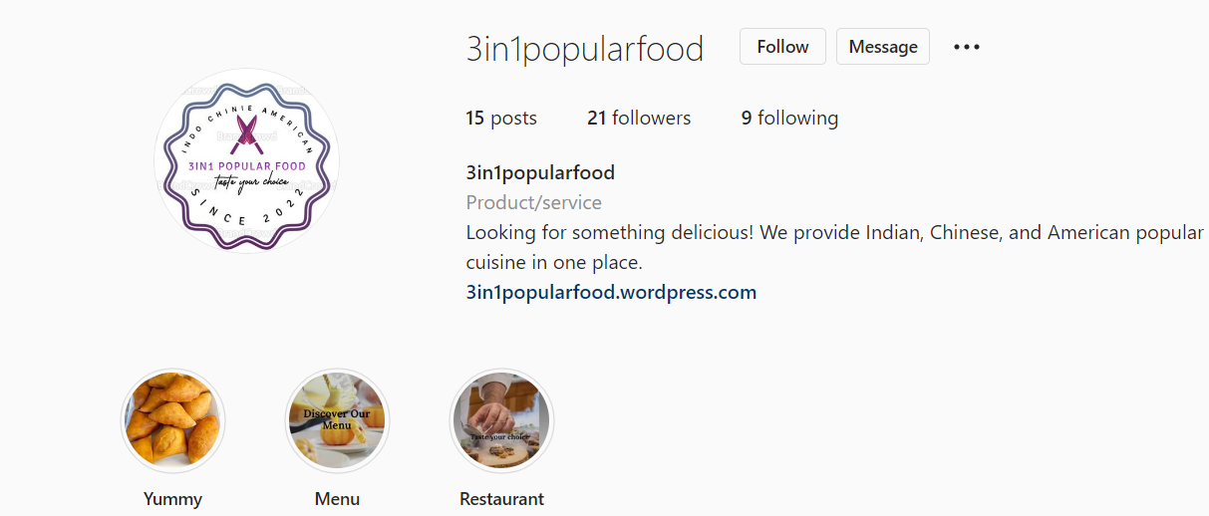
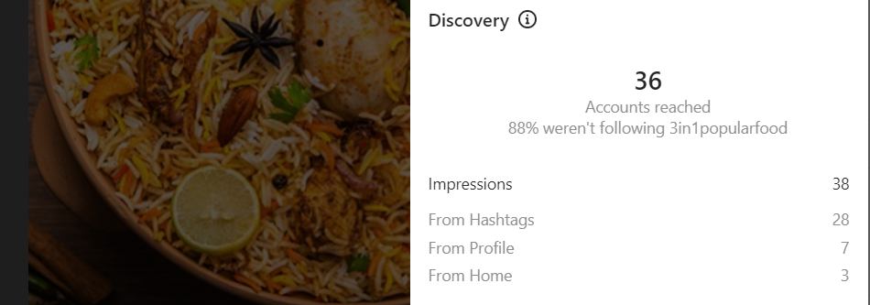
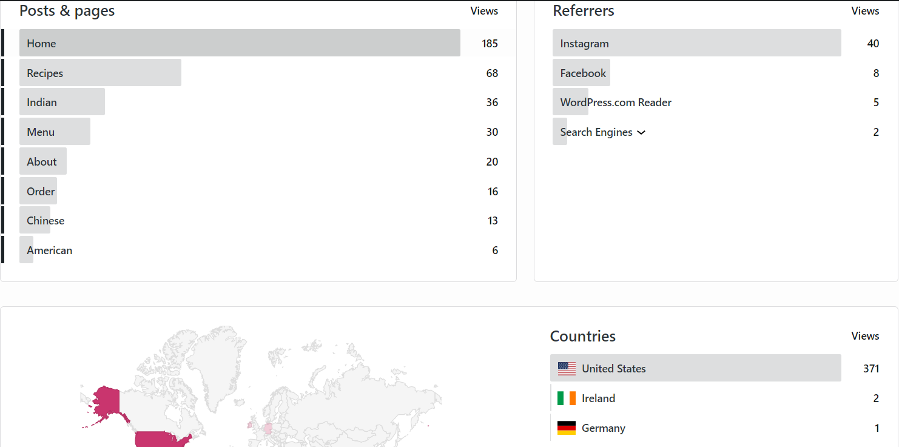
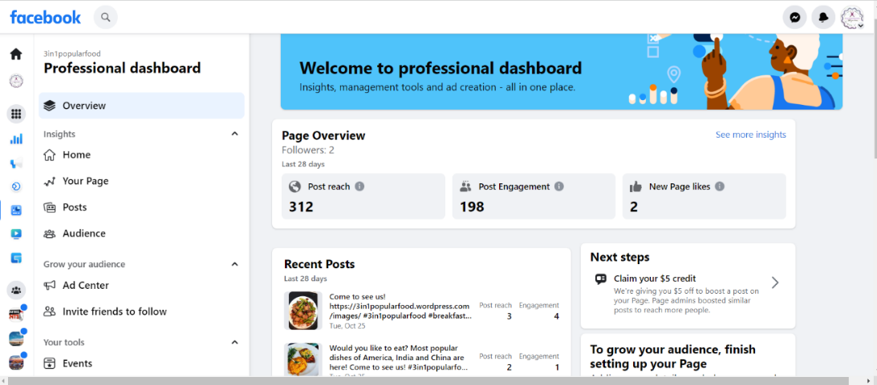
Social media
Social Media acting as a marketing tool
To connect with the audience
To create our brand
To drive website traffic
Platform:
Facebook
Instagram

Slide 8
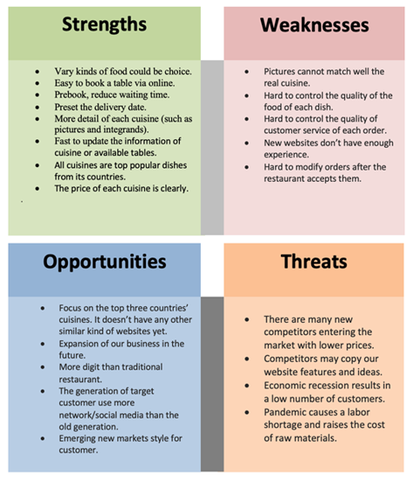
SWOT Analysis

Slide 9
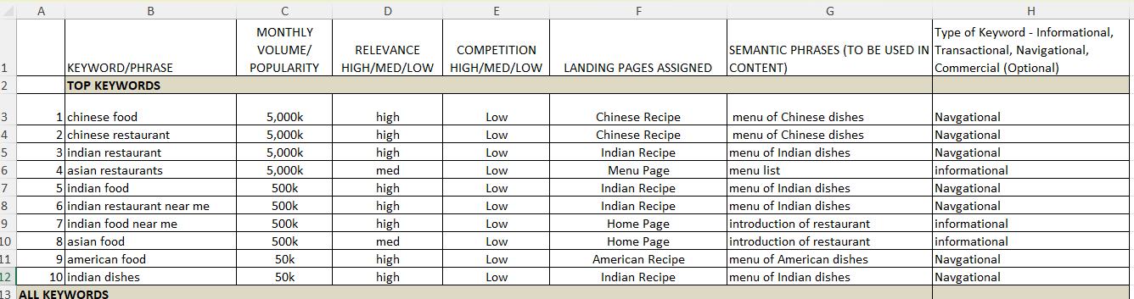
Keywords
Use Google Ads Keyword Planner to generate the relative keywords
Competitive analysis of those keywords
Pick up the 10 keywords in high search volume, relevant to the content, and low in competition.

Slide 10
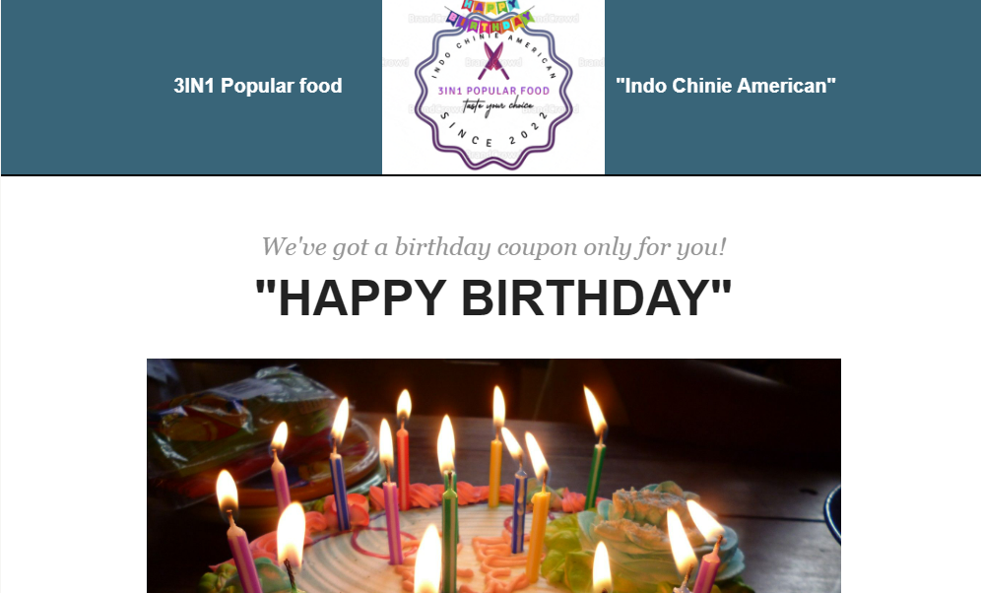
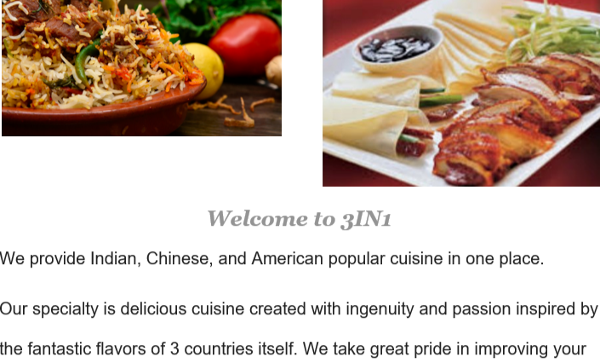
Email Campaign
Used MailChimp to create and design a newsletter
Send the newsletter to our audience
To help the market increase
To increase web traffic
To improve the business
To attract target customers
To build the brand recognition

Slide 11
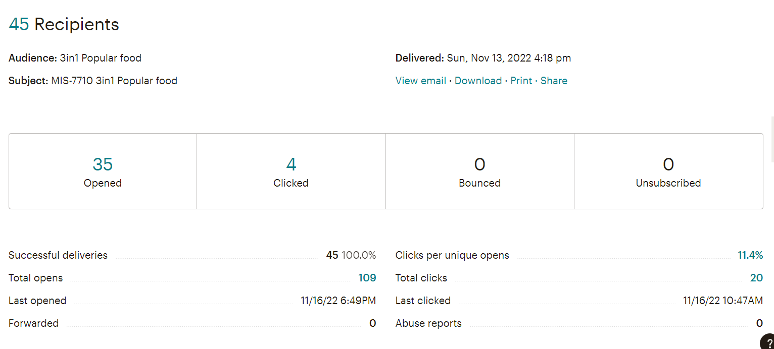
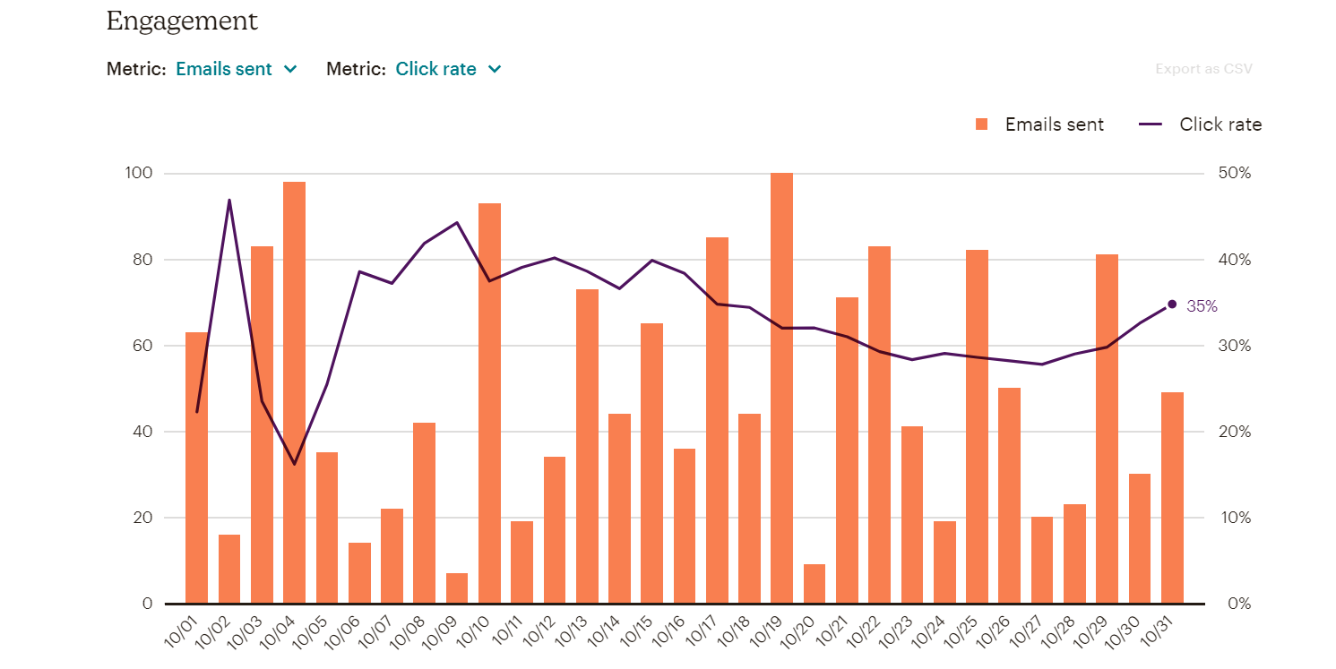
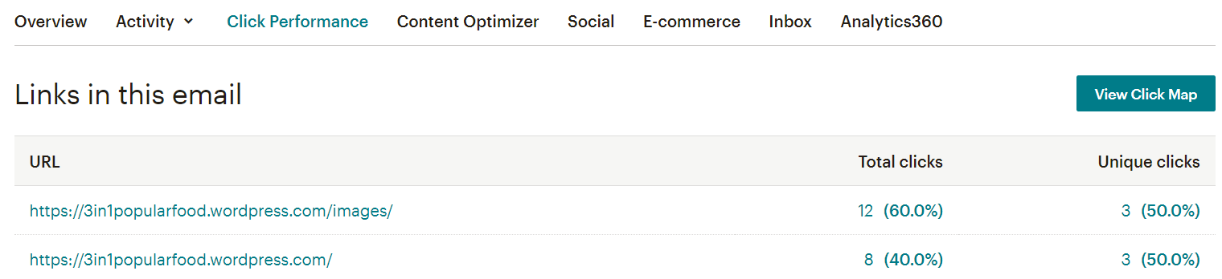
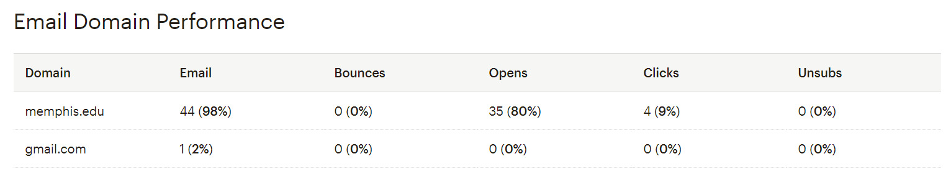
Mailchimp Analysis
Mailchimp report showed a 24-hour performance and activities. The delivery time worked for us. In the report, we saw there were 35 open impressions and 4 clicked impressions between 7 PM to 9 PM.
Notes:
Mailchimp report showed a 24-hour performance and activities. The delivery time worked for us. In the report, we saw there were 35 open impressions and 4 clicked impressions between 7 PM to 9 PM. It was great, opening within one and a half hours. We decided to stick to the same time for future newsletters. Above is the data about the links which were clicked to prove that they worked perfectly. The most clicked URL was the home page of the website.

Slide 12
Summary
Our social media campaign was driving in most of the traffic.
Our email campaign led to the highest conversions.
Homepage was the landing page for most of the users.
Desktop users are more for websites.
Newsletter subscriptions usually happen 3 to 4 days after the email is sent out.
Most of our users are from the USA as we planned.

Slide 13
Future improvements
Improve our Homepage structure to decrease bounce rate.
Increase Social media posts on (Monday, Tuesday, and Wednesday) to drive in more traffic
Add more inventory to the 3 IN 1 menu. This helps in overcoming the huge drop out analyzed zed in behavior flow.
providing excellent customer service
providing healthy, fresh, authentic, and customized food to satisfy customers.
Expanding our business all over the country.

Slide 14
Reference
Bhasin, H. (2019, March 1). The difference between google vs Facebook: The brand fight between 2 Top Internet Brands. Marketing91. Retrieved October 26, 2022, from https://www.marketing91.com/google-vs-facebook/
Wikimedia Foundation. (2022, October 26). Social Media. Wikipedia. Retrieved October 26, 2022, from https://en.wikipedia.org/wiki/Social_media
By. (n.d.). How to track social media traffic using google analytics. Social Media Examiner. Retrieved October 27, 2022, from https://www.socialmediaexaminer.com/track-social-media-traffic-google-analytics/

Slide 15

THANK YOU

